Slide 1
网络安全原理与实践
林峰
2024年春季学期

Slide 2
Lecture 6 Email Security
林峰
flin@zju.edu.cn

Slide 3
Email?
Notes:
1971年的一天，Tomlinson完成了世界上第一封真正名义上的电子邮件发送。1987年9月，CANET（中国学术网）内容为“Across the Great Wall we can reach every corner in the world ”（“越过长城，走向世界”）

Slide 4
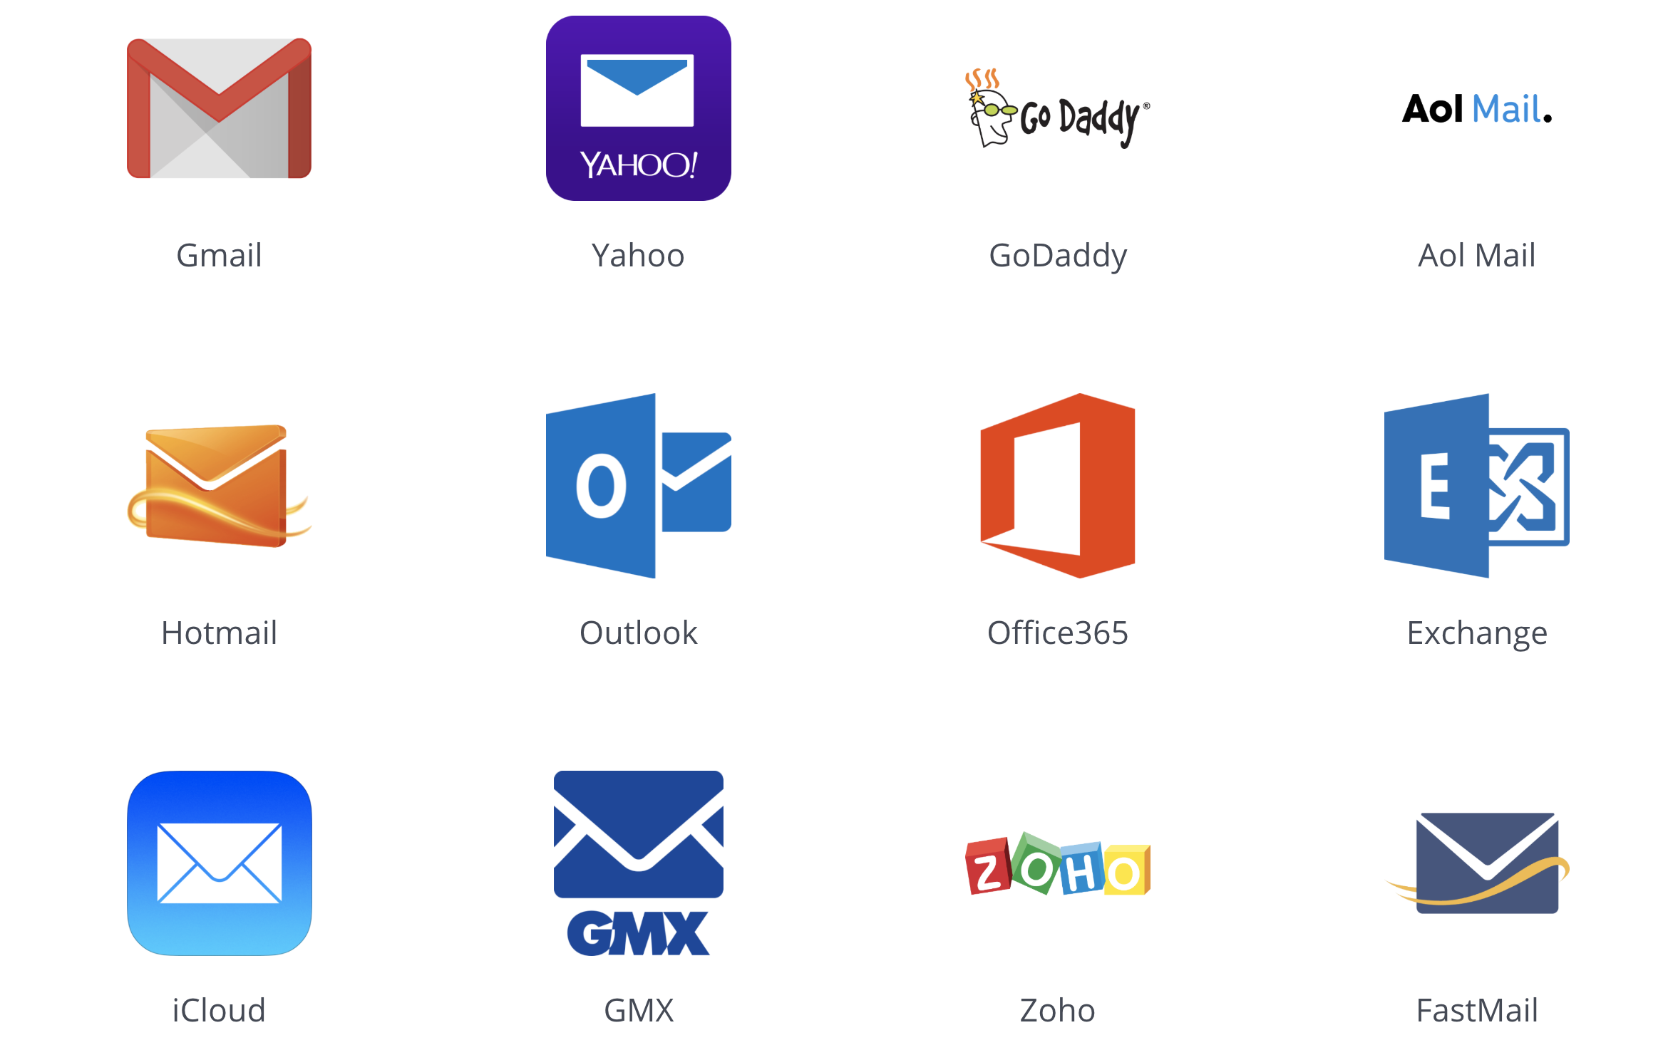
Electronic Mail
for exchanging electronic messages

Slide 5
Email Architecture
MUA: Message User Agent hosted on a client email program or a local network email server; sender MUA formats a message and performs initial submission into MHS via a MSA (Mail Submission Agent); recipient MUA processes received email for storage and/or display to the recipient user
MHS: Message Handling Service
Notes:
MSA (Mail Submission Agent)

Slide 6
Email Architecture
MUA: Message User Agent
MHS: Message Handling Service composed of MTAs (Message Transfer Agents); accepts a message from sender and delivers it to one or more recipients; creates a virtual MUA-to-MUA environment;

Slide 7
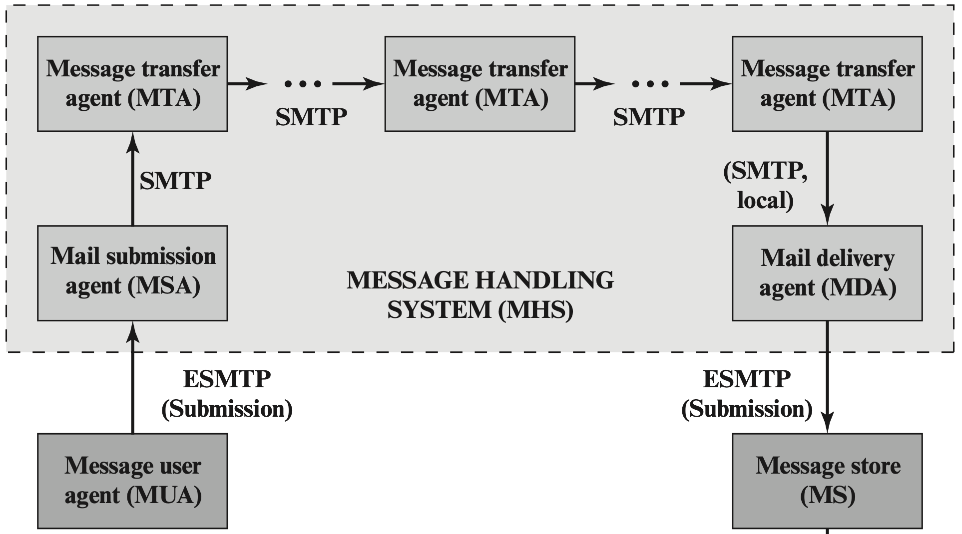

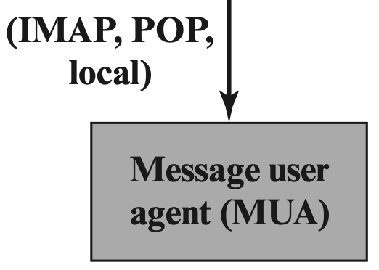
Email Architecture
sender
recipient
Notes:
Simple Mail Transfer Protocol (SMTP)
Mail Submission Agent (MSA): Accepts the message submitted by an MUA
Mail Delivery Agent (MDA): Responsible for transferring the message from the MHS to the MS.

Slide 8
Email Architecture
sender
ADMD: email service provider
administrative management domain
recipient
Notes:
ADMD, an IT department that operates an enterprise mail relay, and an ISP that operates a public shared email service.

Slide 9
Email Protocol
Type 1: SMTP Simple Mail Transfer Protocol move messages through the Internet from source to destination;
Type 2: IMAP and POP Internet Mail Access Protocol; Post Office Protocol; transfer messages between mail servers
Notes:
Two types of protocols are used for transferring email. The first type is used to move messages through the Internet from source to destination. The protocol used for this purpose is SMTP, with various extensions and in some cases restrictions. The second type consists of protocols used to transfer messages between mail servers, of which IMAP and POP are the most commonly used.

Slide 10
Email Format
RFC 5322 view messages as having an envelope and contents; envelope contains whatever information needed to accomplish transmission and delivery; contents compose the object to be delivered to the recipient;

Slide 11
Email Format
RFC 5322 view messages as having an envelope and contents; RFC 5322 applies only to the contents;
the content standard includes a set of header fields that may be used by the mail system to create the envelope;

Slide 12
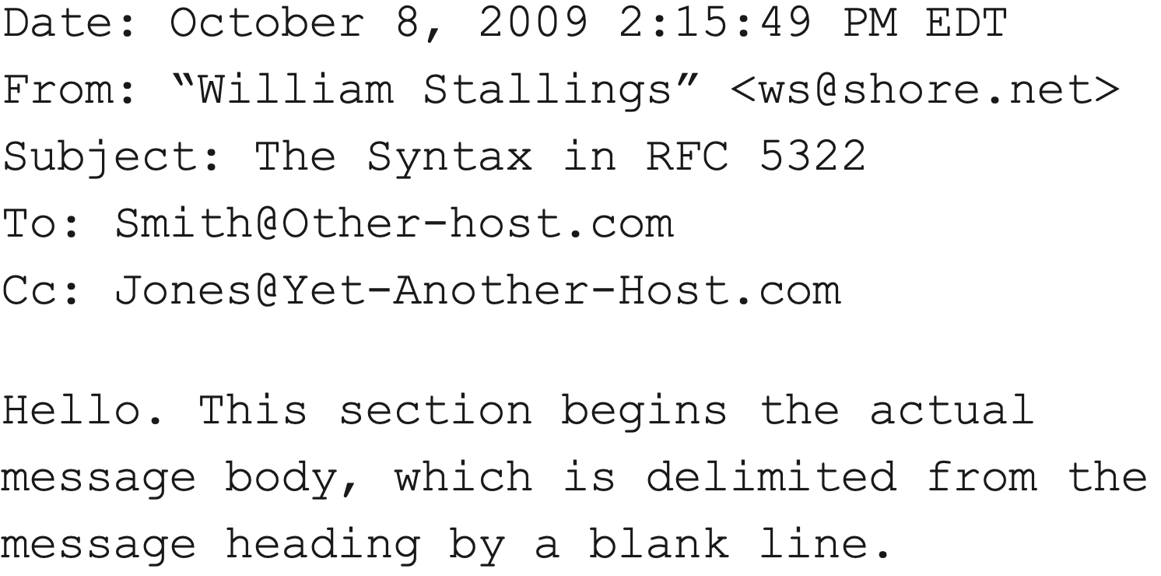
Email Format
RFC 5322 header + body seperated by a blank line in ASCII form

Slide 13
Email Format
MIME Multipurpose Internet Mail Extensions extend RFC 5322 with enhancements;

Slide 14
Email Format
MIME
Define five new header fields to provide information about message content
Standardize representations that support multimedia electronic mail
Define transfer encodings that enable the conversion of any content format into a form that is protected from alteration by the mail system

Slide 15
MIME Header
MIME-Version
Content-Type
Content-Transfer-Encoding
Cotent-ID
Content-Description

Slide 16
MIME Header
MIME-Version parameter value should be 1.0, indicating that the message conforms to RFCs 2045 and 2046

Slide 17
MIME Header
Content-Type describe the data contained in the body with sufficient detail, so that the recipient agent can pick an appropriate agent or mechanism to represent the data to the recipient or deal with the data in an appropriate manner
Notes:
下一页

Slide 18
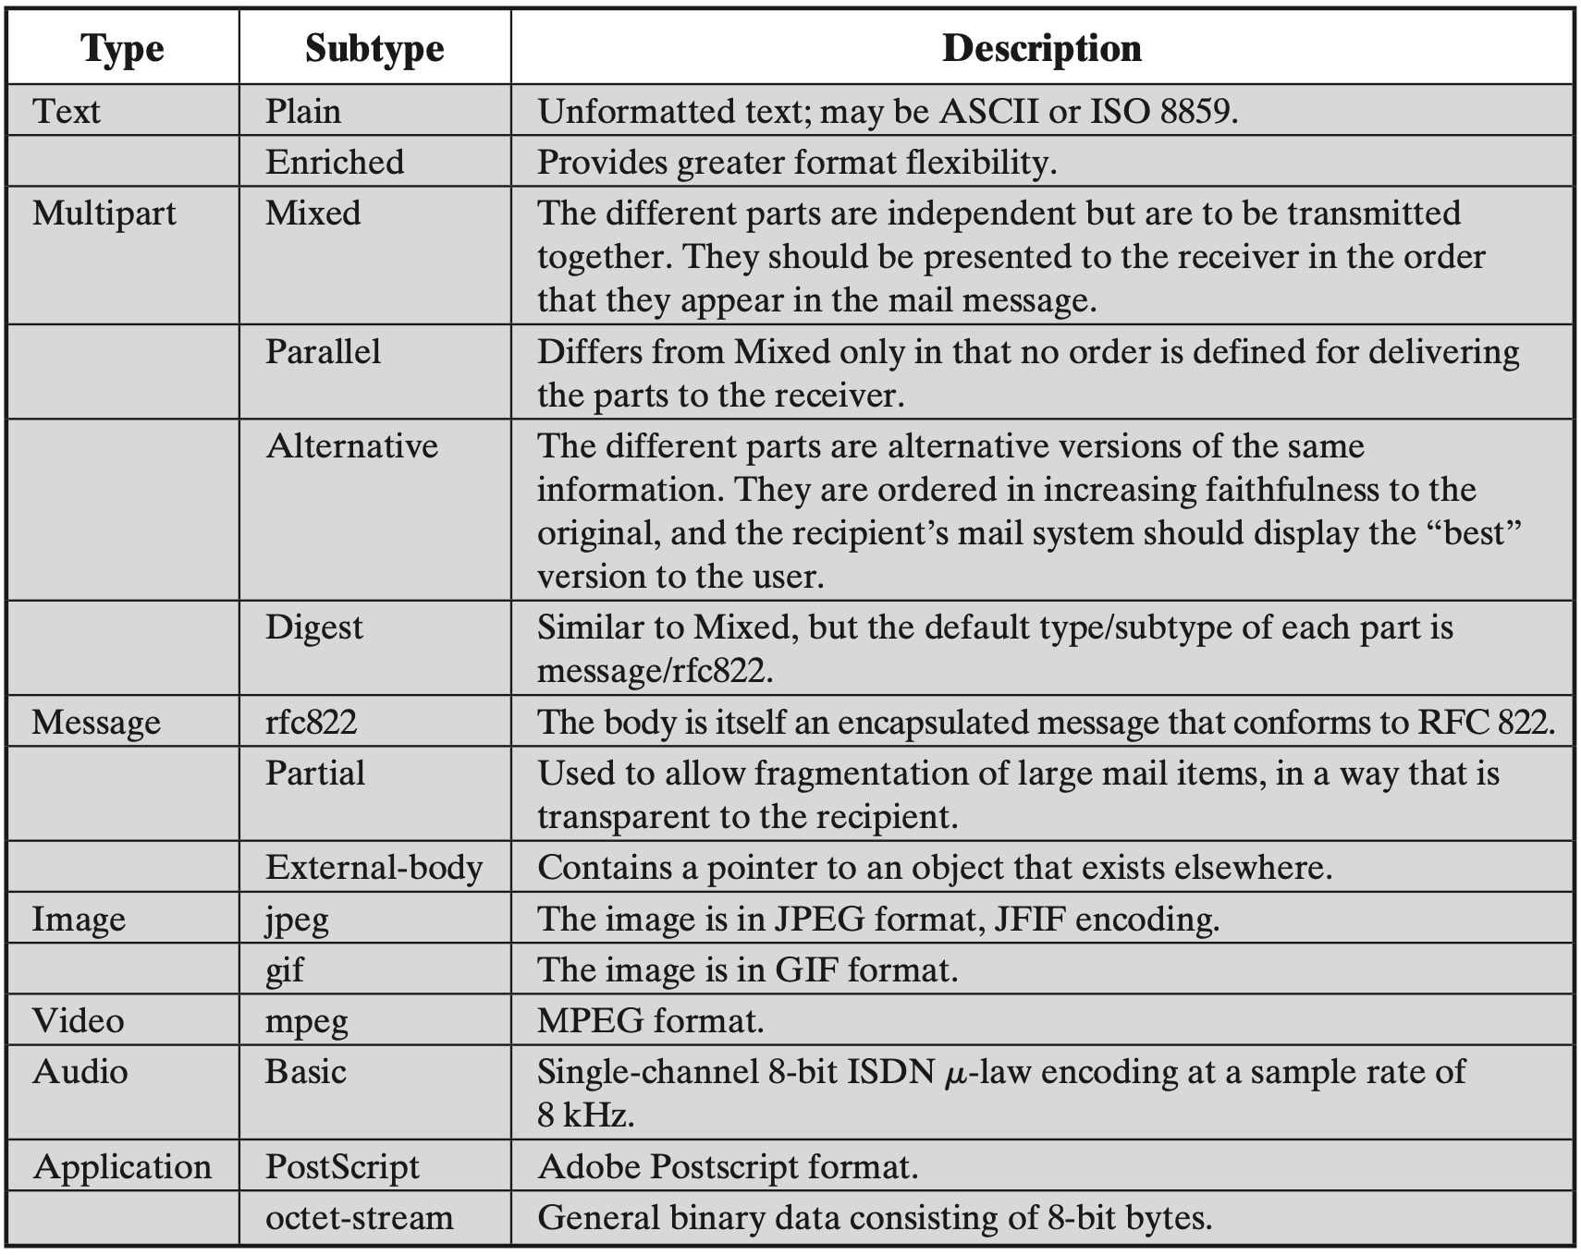
MIME Content Type
Notes:
content types specified in RFC 2046. There are seven different major types of content and a total of 15 subtypes

Slide 19
MIME Header
Content-Transfer-Encoding indicate the type of information used to represent message body, should be acceptable for mail transport
Notes:
下一页

Slide 20
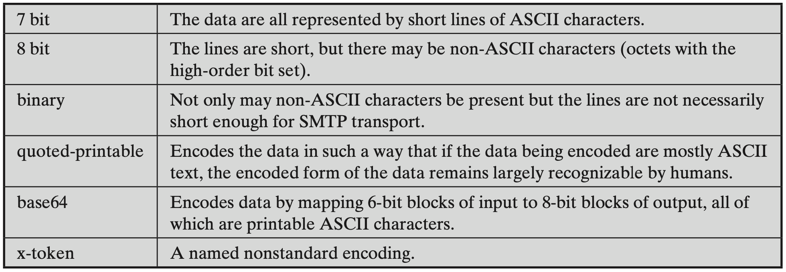
MIME Transfer Encoding
Provide reliable delivery across the largest range of environments
Notes:
three of these values (7-bit, 8-bit, and binary) indicate that no encoding has been done but provide some information about the nature of the data.
x-token, indicates that some other encoding scheme is used for which a name is to be supplied.

Slide 21
MIME Header
Content-ID identify MIME entities uniquely in multiple contexts
Content-Description text description of the object with body; useful when the object is not readable (e.g., audio data)
both fields are optional and may be ignored by the recipient implementation

Slide 22
Email Security?

Slide 23
Email Security Threats
Authenticity-related Threats
Integrity-related Threats
Confidentiality-related Threats
Availability-related Threats

Slide 24
Email Security Threats
Authenticity-related Threats could result in unauthorized access to an email system
Notes:
真实性

Slide 25
Email Security Threats
Integrity-related Threats could result in unauthorized modification of email content

Slide 26
Email Security Threats
Confidentiality-related Threats could result in unauthorized disclosure of sensitive information

Slide 27
Email Security Threats
Availability-related Threats could prevent end users from being able to send or receive email

Slide 28
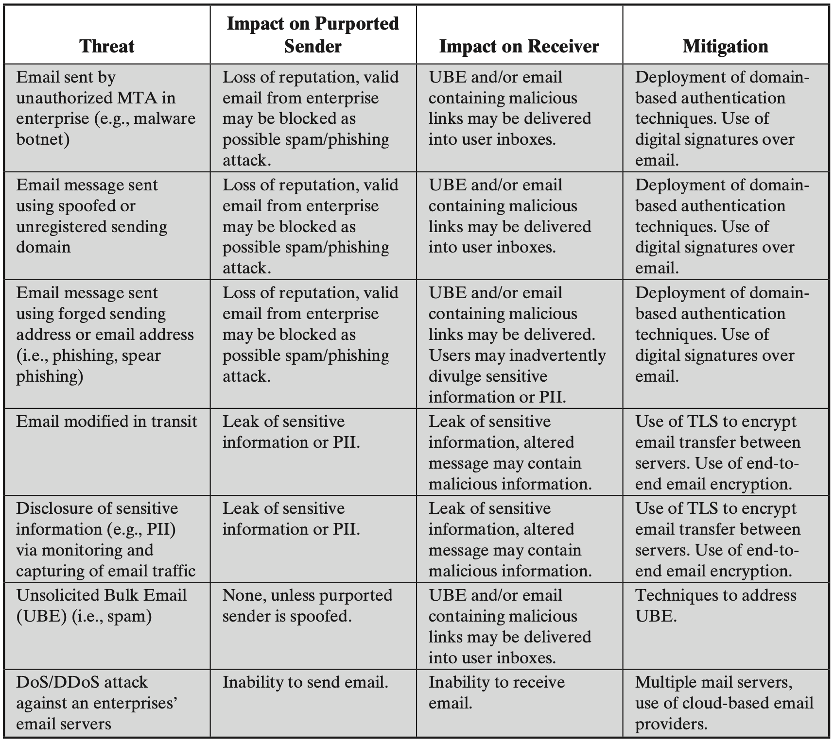
Threats and Mitigations

Slide 29
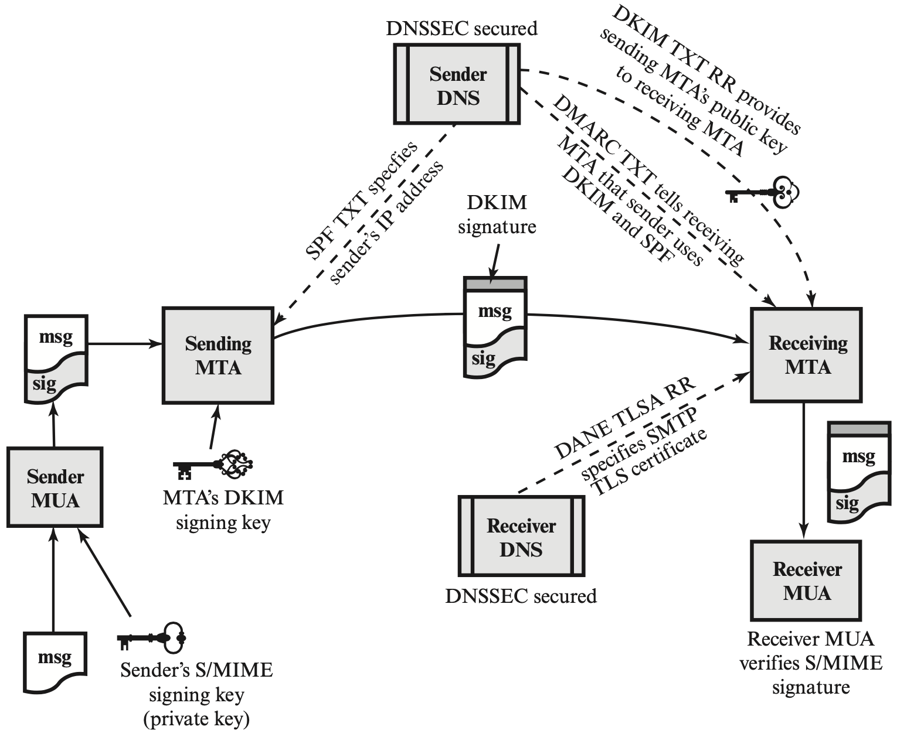
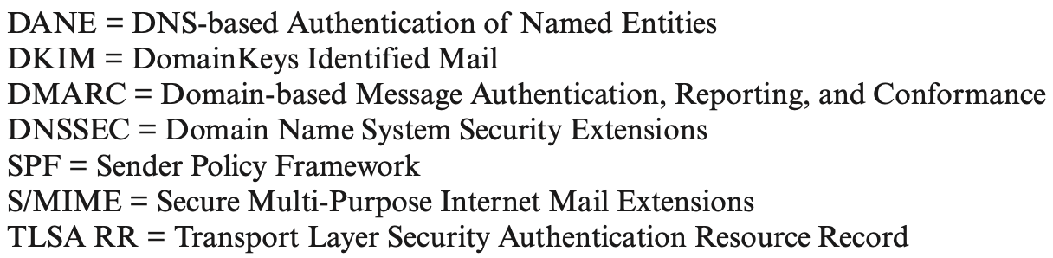
Authenticity and Integrity
Notes:
The Interrelationship

Slide 30
S/MIME
Secure/Multipurpose Internet Mail Extension

Slide 31
S/MIME
Authentication
Confidentiality
Compression
Email compatability
Notes:
提供的功能

Slide 32
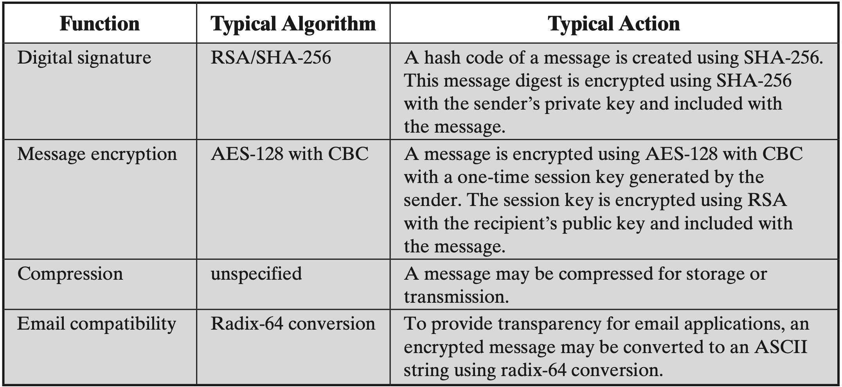
S/MIME

Slide 33
Authentication
1. the sender creates a message
2. use SHA-256 to generate a 256-bit message digest
3. encrypt the message digest with RSA using the sender’s private key; append the result as well as the signer’s identity to the message
4. the receiver uses RSA with the sender’s public key to decrypt, recover, and verify the message digest
Notes:
message digest
消息摘要
第三步—就是数字证书

Slide 34
Confidentiality
1. the sender creates a message and a random 128-bit number as a content-encryption key for this message only
2. encrypt the message using the content-encryption key
3. encrypt the content-encryption key with RSA using the receiver’s public key and append it to the message
Notes:
两次加密

Slide 35
Confidentiality
4. The receiver uses RSA with its private key to decrypt and recover the content-encryption key
5. use the content-encryption key to decrypt the message
Notes:
两次解密

Slide 36
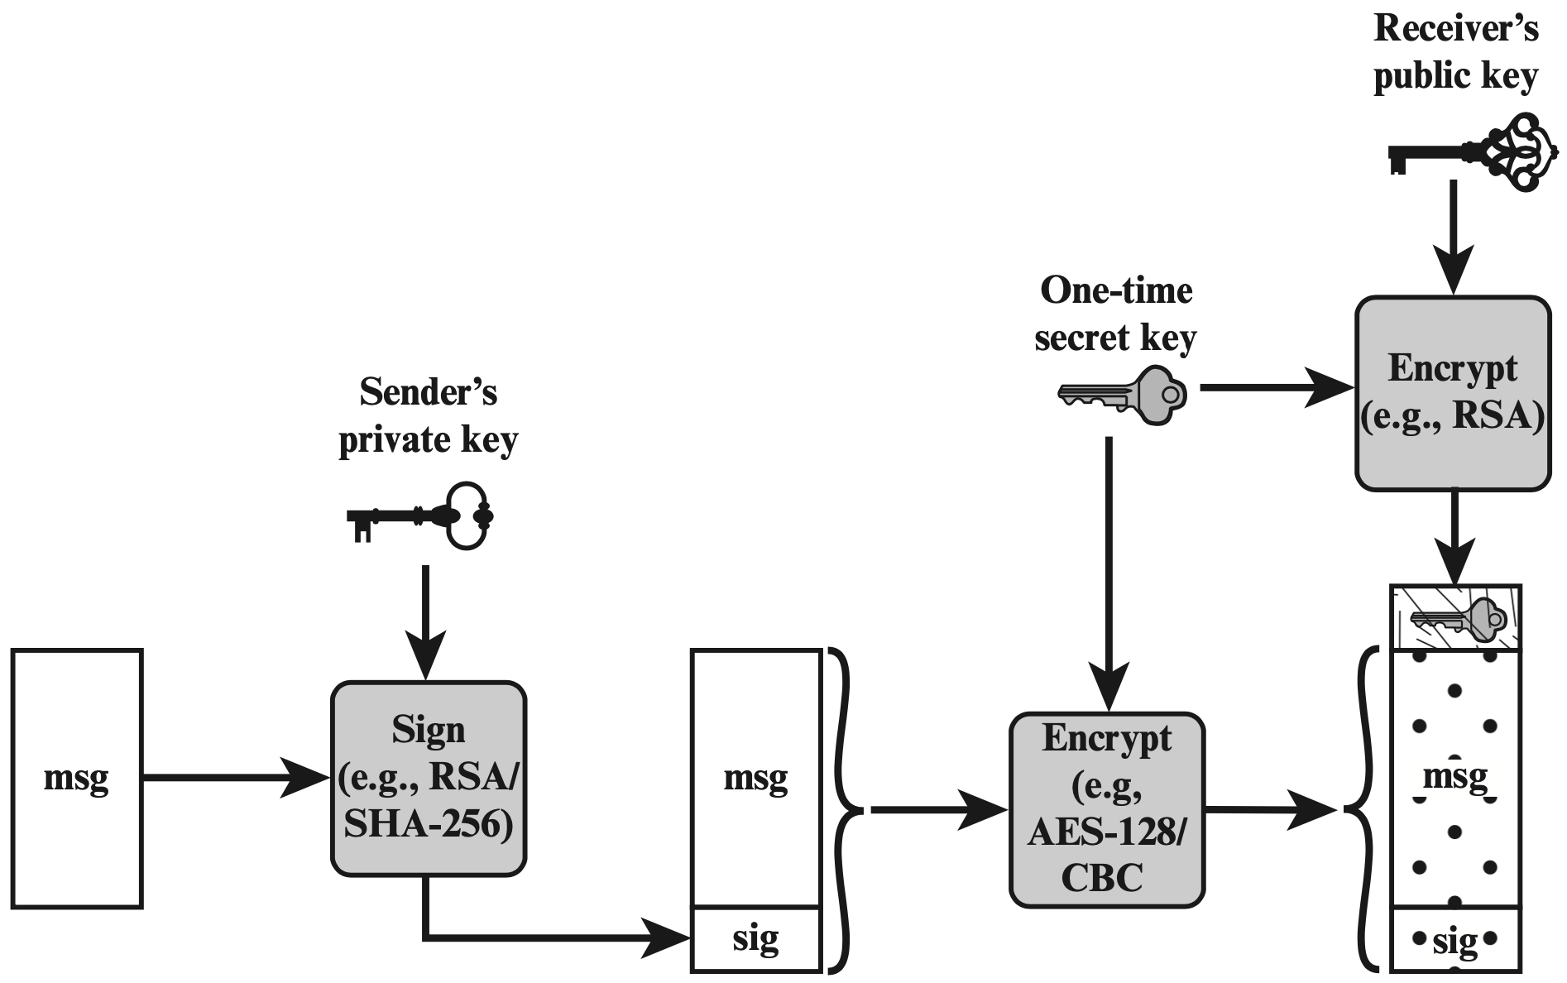
Authentication
&Confidentiality
sender signs and encrypts message

Slide 37
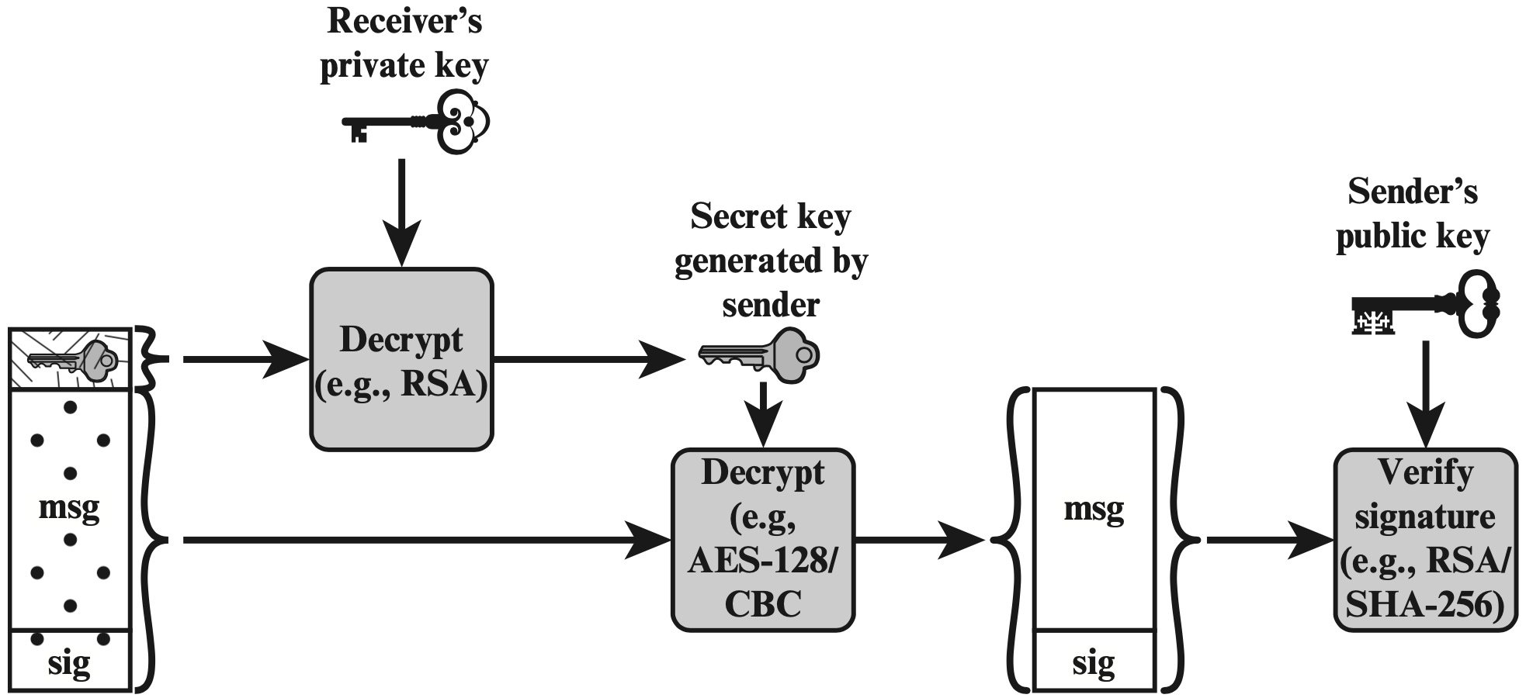
Authentication
&Confidentiality
receiver decrypts message and verifies sender’s signature

Slide 38
Content Type
Data inner MIME-encoded message content; may be encapsulated in the following types;
SignedData
EnvelopedData
CompressedData

Slide 39
Content Type
Data inner MIME-encoded message content;
SignedData digital signature of a mesasge
EnvelopedData encrypted data of any type, and encrypted content-encryption keys for one or more recipients;
CompressedData data compression of a message

Slide 40
PGP
Pretty Good Privacy
same functionality as S/MIME
free and popular for personal use
Notes:
An alternative email security protocol is Pretty Good Privacy (PGP), which has essentially the same functionality as S/MIME.
It was made available free of charge and became quite popular for personal use.

Slide 41
PGP
Differences from S/MIME:
Key Certification S/MIME uses X.509 certificates issued by CA or delegated authorities; OpenPGP allows users to generate their own OpenPGP public and private keys, and then solicit signatures for their public keys from known individuals or organizations
Key Distribution

Slide 42
PGP
Differences from S/MIME:
Key Certification
Key Distribution OpenPGP does not include the sender’s public key with each message; recipient needs to separately obtain that from TLS-protected websites or OpenPGP public key servers; no vetting of OpenPGP keys, users decide whether to trust on their own
Notes:
Vetting 审核

Slide 43
PGP
Differences from S/MIME:
Key Certification
Key Distribution
NIST 800-177 recommends the use of S/MIME rather than PGP because of the greater confidence in the CA system of verifying public keys
Notes:
CA certificate authority

Slide 44
What if CA is compromised?
Notes:
However, if any of the hundreds of CAs operating on the Internet is compromised, the effects can be widespread. The attacker can obtain the CA’s private key, get issued certificates under a false name, or introduce new bogus root certificates into a root certificate store. There is no limitation of scope for the global PKI and a compromise of a single CA damages the integrity of the entire PKI system. In addition, some CAs have engaged in poor security practices. For example, some CAs have issued wildcard certificates that allow the holder to issue sub-certificates for any domain or entity, anywhere in the world.

Slide 45
What if CA is compromised?
steal CA’s private key
issue false certificates
Notes:
攻击者可以获取 CA 的私钥，以假名称获取颁发的证书，或将新的虚假根证书引入根证书存储。
The attacker can obtain the CA’s private key, get issued certificates under a false name, or introduce new bogus root certificates into a root certificate store.

Slide 46
DANE!
DNS-based Authentication of Named Entities
allow X.509 certificates to be bound to
DNS names using DNSSEC
DNSSEC: DNS Security Extension
Notes:
DANE 的目的是用对 DNSSEC 提供的安全性的依赖来取代对 CA 系统安全性的依赖。

Slide 47
TLSA Record
TLS Authentication record
A new DNS record type defined by DANE
Used for a secure method of authenticating SSL/TLS certificates
Notes:
DANE 通过Transport Layer Security Authentication: TLSA来实现
它用于验证与目标服务器建立安全连接的数字证书。

Slide 48
TLSA Record
Specify constraints on which CA can vouch for a certificate, or which specific PKIX [Public Key Infrastructure (X.509)] end-entity certificate is valid
Specify that a service certificate or a CA can be directly authenticated in the DNS itself
Notes:
TLSA资源记录的结构非常简单，它们指定了哪个服务（域，IP协议，端口），X.509证书的类型以及相应的Base64编码的哈希
Vouch 担保
a service certificate or a CA 后面会提

Slide 49
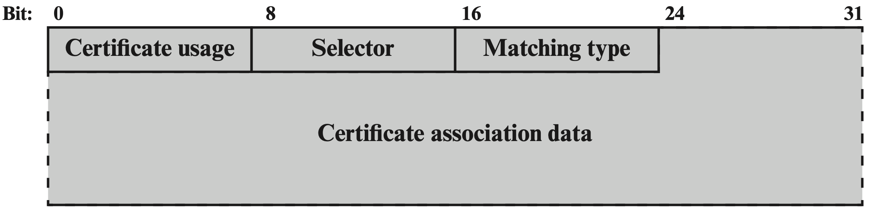
TLSA Record
format of TLSA as it is transmitted to a requesting entity
Notes:
Transmission Format 传输的格式

Slide 50
TLSA Record
Certificate Usage define four different usage models, to accommodate users who require different forms of authentication
Notes:
Certificate usage field

Slide 51
TLSA Record
Certificate Usage PKIX-TA (CA constraint): Specifies which CA should be trusted to authenticate the certificate for the service

Slide 52
TLSA Record
Certificate Usage PKIX-EE (service certificate constraint): Defines which specific end entity service certificate should be trusted for the service

Slide 53
TLSA Record
Certificate Usage DANE-TA (trust anchor assertion): Specifies a domain-operated CA to be used as a trust anchor
Notes:
“Domain-operated CA” 则是指由特定域（组织、公司等）运营的证书颁发机构。不同于公开的证书颁发机构（如 Let’s Encrypt, VeriSign, GeoTrust 等），一个域运营的 CA 通常是为了内部使用，比如为公司内部服务器、设备或用户颁发证书，以确保内部通信的安全和加密

Slide 54
TLSA Record
Certificate Usage DANE-EE (domain-issued certificate): Specifies a domain-operated CA to be used as a trust anchor

Slide 55
TLSA Record
Selector indicate whether the full certificate will be matched or just the value of the public key

Slide 56
TLSA Record
Matching Type indicate how the match of the certificate is made: exact match, SHA-256 hash match, or SHA-512 hash match

Slide 57
TLSA Record
Certificate Association Data represent the raw certificate data in hex format

Slide 58
DANE for SMTP
Targeted vulnerabilities:
attackers can strip away the TLS capability advertisement and downgrade the connection to not use TLS;
TLS connections are often unauthenticated (e.g., the use of self-signed certificates as well as mismatched certificates is common)
Notes:
strip away 除去 揭掉

Slide 59
DANE for SMTP
A domain can use the presence of TLSA as an indicator that encryption must be performed, thus preventing malicious downgrade
A domain can authenticate the certificate used in the TLS connection setup using a DNSSEC-signed TLSA
Notes:
Domain 跟 TLSA关系

Slide 60
DANE for S/MIME
Introduce a SMIMEA DNS record to associate certificates with DNS domain names
Help MUAs to deal with domain names as specified in email addresses in the message body (rather than domain names specified in the outer SMTP envelope – purpose of TLSA)

Slide 61
Remember IP spoofing?
a host can use any domain name in header,
not just the domain name where the host
is located

Slide 62
SPF
Sender Policy Framework ADMDs (Administrative Management Domains) publish SPF records in DNS specifying which hosts/IP-addresses are permitted to use their names; receivers use the published SPF records to test the authorization of sending Mail Transfer Agents (MTAs) using a given “HELO” or “MAIL FROM” identity during a mail transaction;

Slide 63
DKIM
Domain Keys Identified Mail sign email message by a private key of the administrative domain from which the email originates; at the receiving end, the MDA can access the corresponding public key via a DNS and verify the signature, thus authenticating that the message comes from the claimed administrative domain

Slide 64
DKIM
Difference from S/MIME and PGP S/MIME and PGP use the sender’s private key to sign the content of the message;
DKIM uses the private key of the domain where the sender locates;

Slide 65
Email protected per security

Slide 66
What if Email is exploited?

Slide 67
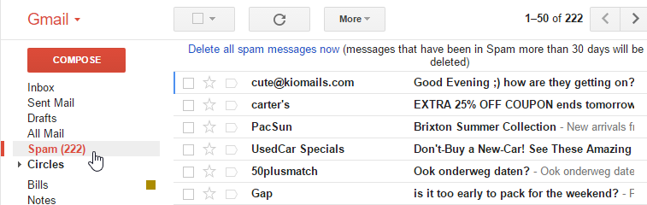
Spam
Unwanted email advertisements
https://edu.gcfglobal.org/en/internetsafety/avoiding-spam-and-phishing/1/

Slide 68
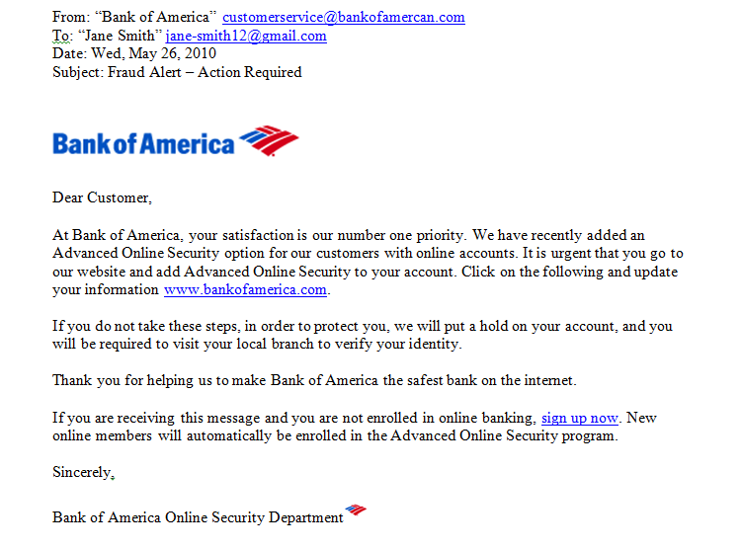
Phishing
use deceptive email addresses;
trick receivers into providing sensitive information;
https://edu.gcfglobal.org/en/internetsafety/avoiding-spam-and-phishing/1/

Slide 69
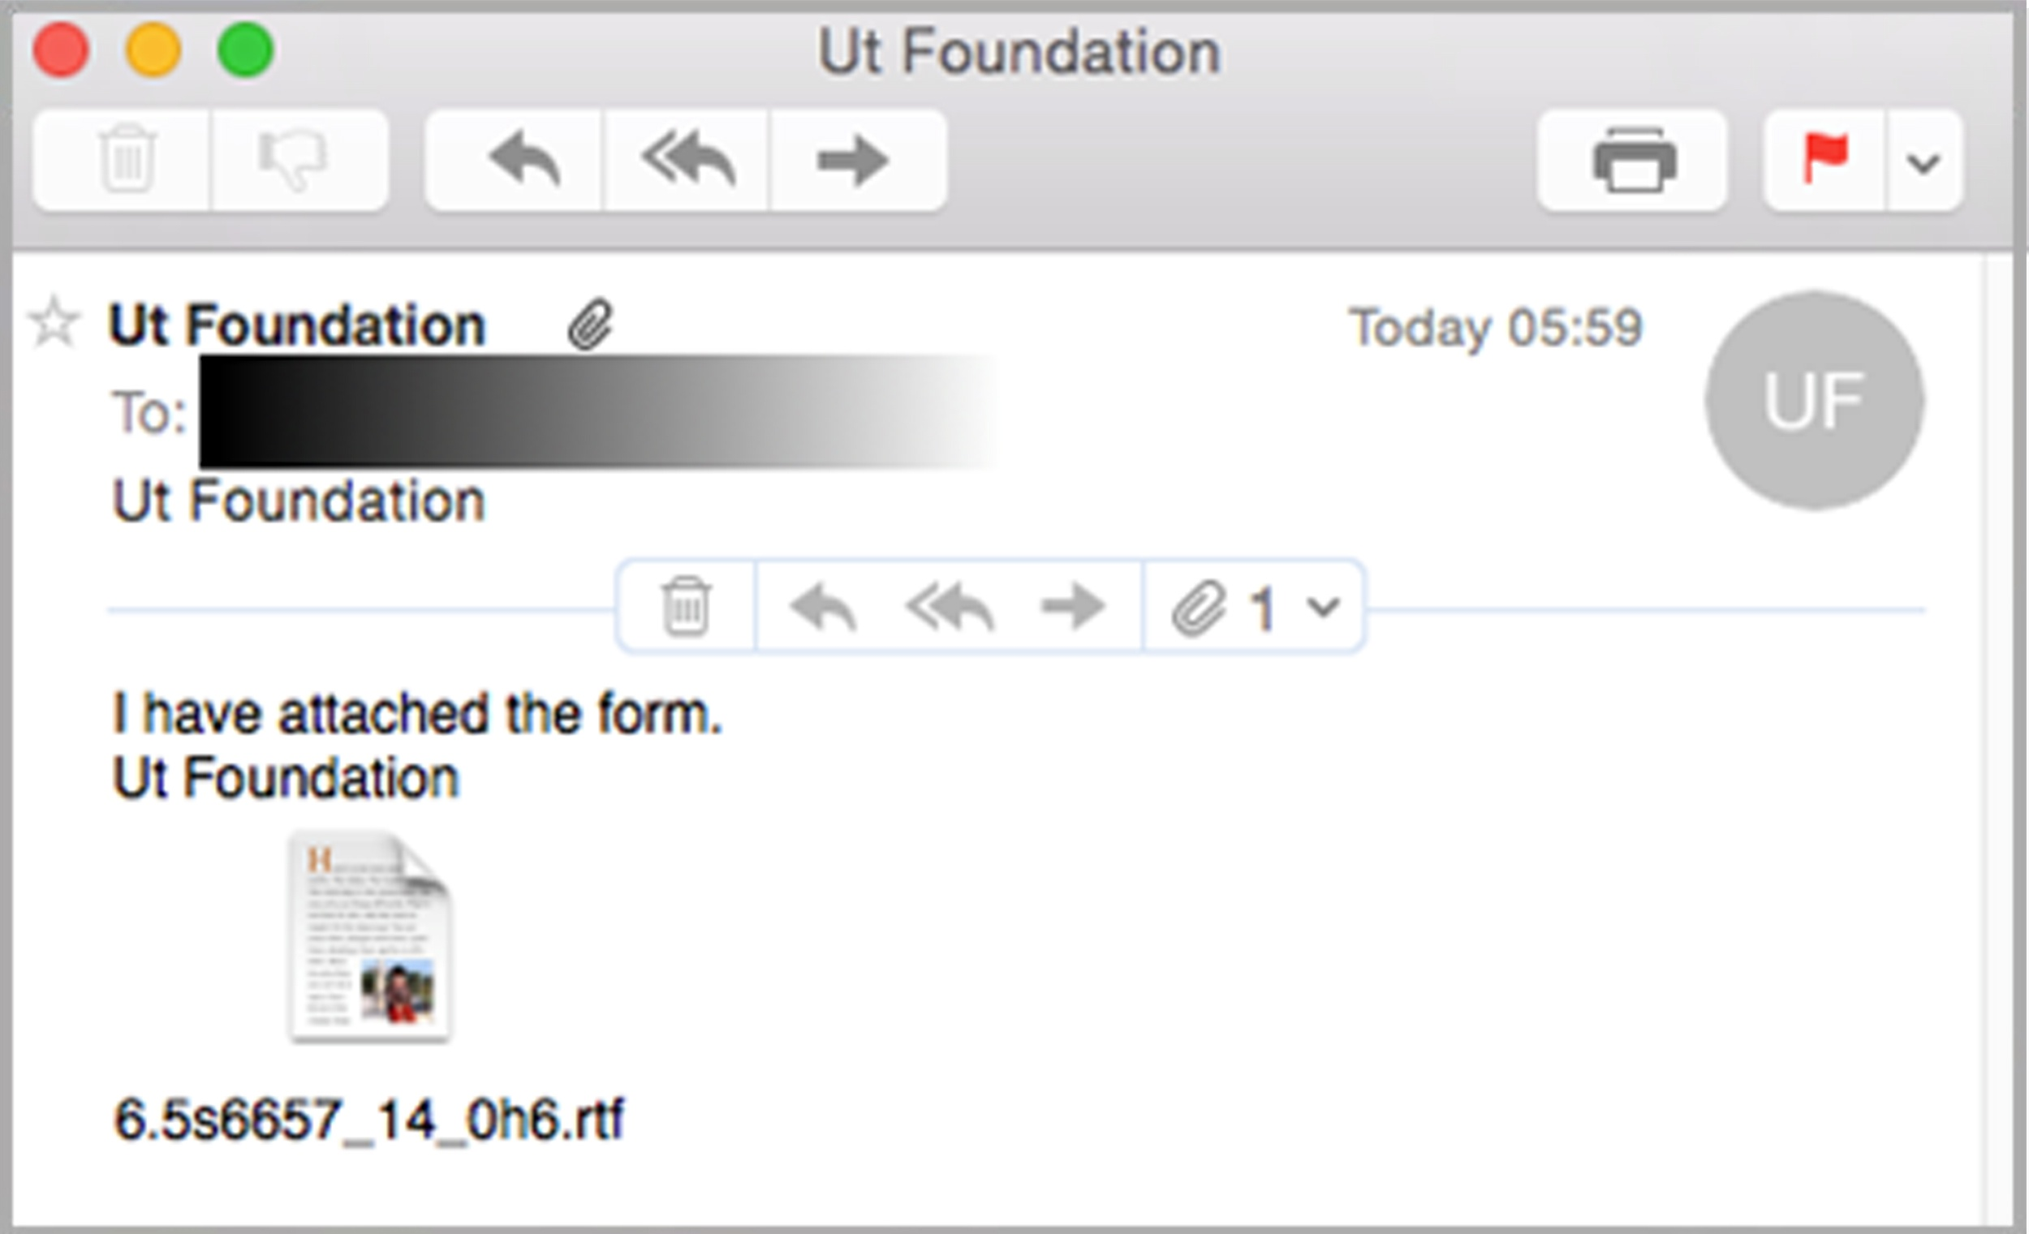
Malware
Spread via malicious email attachments
Commonly suspicious file types: .bat, .exe, .vbs, .com, .ade, .rtf, etc.
https://www.mailguard.com.au/blog/breaking-unprecedented-rtf-attachment-malware-attack-impacting-millions

Slide 70
Readings
Cryptography and Network Security: Principles and Practice
by William Stallings
Chapter 19: Electronic Mail Security
Avoiding Spam and Phishing
by LearnFree.org

